Slide 1
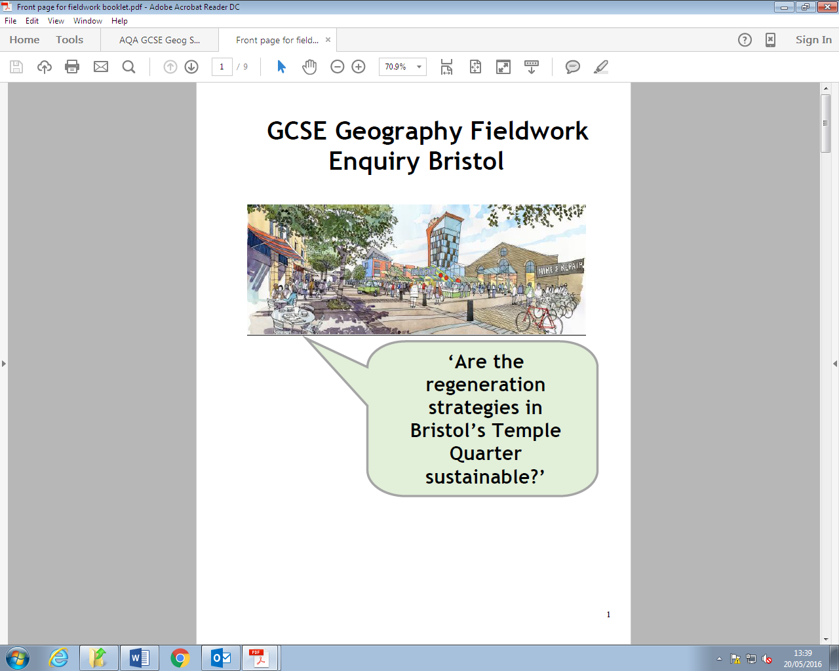


Human Geography Fieldwork
Do Now: What data did you collect about
Cleanliness?
Accessibility?
Range of Landuse?
How will this help us answer our key question?
Is the regeneration of Temple Quarter achieving its vision?
Learning Objective: Present, interpret and evaluate our findings

Slide 2

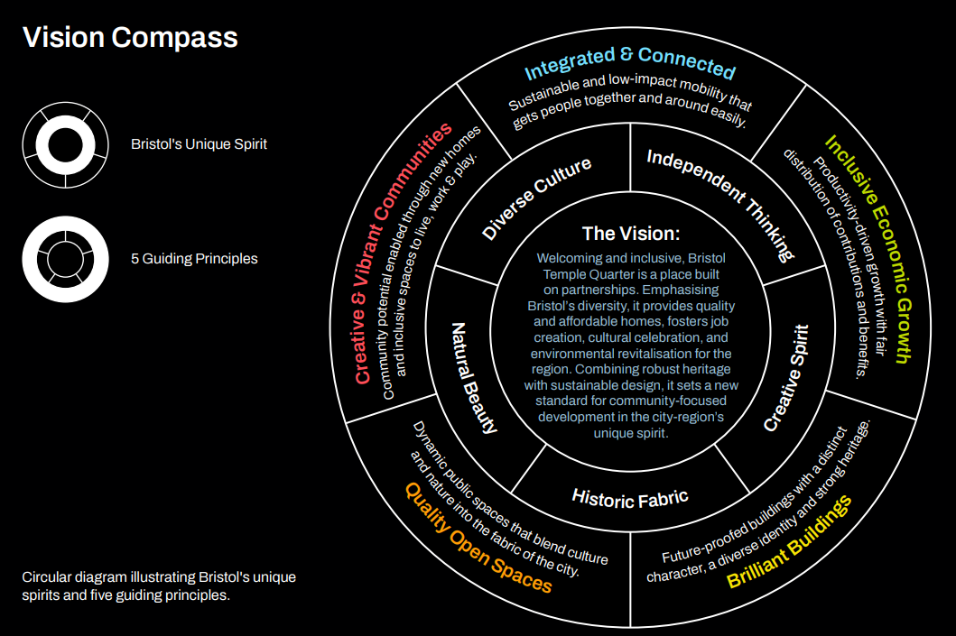
What is the vision for Temple Quarter?
‘Welcoming and inclusive, Bristol Temple Quarter is a place built on partnerships. Emphasising Bristol’s diversity, it provides quality and affordable homes, fosters job creation, cultural celebration, and environmental revitalisation for the region. Combining robust heritage with sustainable design, it sets a new standard for community-focused development in the city-region’s unique spirit.’

Slide 3
Reminder: What hypotheses are we testing?
We will find out if Temple Quarter’s regeneration is achieving its vision by testing three hypotheses:
Hypothesis 1: Regenerated areas will be cleaner than areas which haven’t been regenerated. Clean areas are a sign that an area is thriving socially.
Hypothesis 2: Regenerated areas will be more accessible than areas which haven’t been regenerated. Accessibility is an important aspect of a community being inclusive.
Hypothesis 3: Regenerated areas will have fewer empty buildings, a wider range of land use and more ‘brilliant buildings’ than in areas that haven’t been regenerated. Buildings in use in a range of ways indicate an area is mixed use and is thriving economically.

Slide 4

Secondary research
We will find out more about the accessibility of each area by finding out how well connected it is by public transport.
We will find out how far each location is from Temple Meads and use the internet to find out about bus routes in each location.
How does this data link to our hypotheses?
What is the difference between primary and secondary data collection?
https://www.youtube.com/watch?v=zSdnd9MznPk

Slide 5


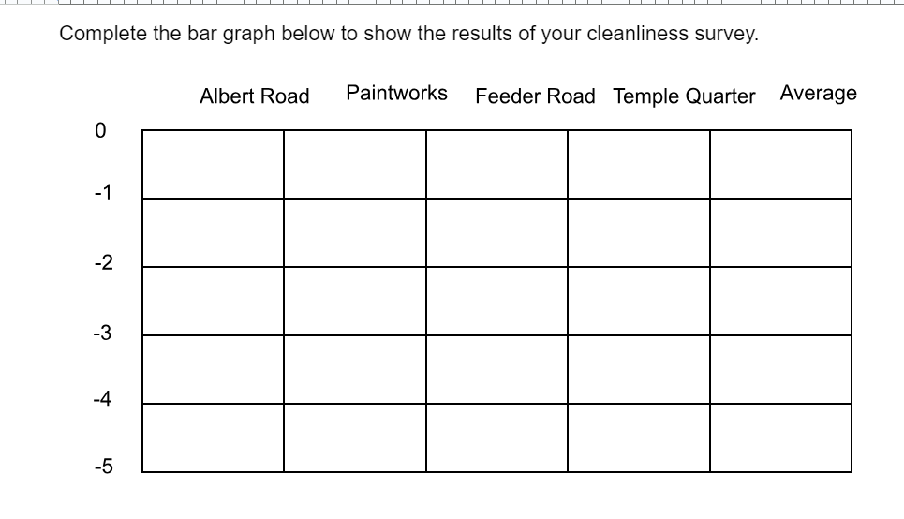
Data Presentation: Cleanliness Survey
Your teacher will give you a sheet with a bar graph to complete to show your results.
Why do you think you are drawing bars that go down, not up?
Answer the questions under the graph on the sheet - you will need to know these answers for your Paper 3 exam.
You could watch the first part of this video to review bar graphs & their use - https://www.youtube.com/watch?v=o7F-tbBl_hA

Slide 6
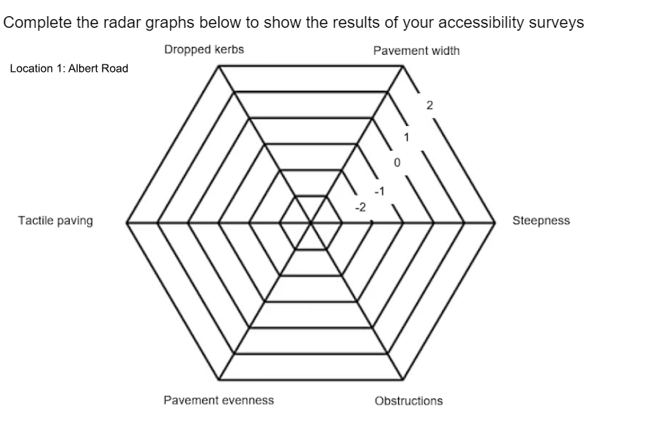
Data Presentation: Accessibility Survey
Your teacher will give you a sheet with a set of radar graphs to complete to show your accessibility scores for each location.
They will model how to do this.
Answer the questions under the graphs on the sheet - you will need to know these answers for your Paper 3 exam.

Slide 7
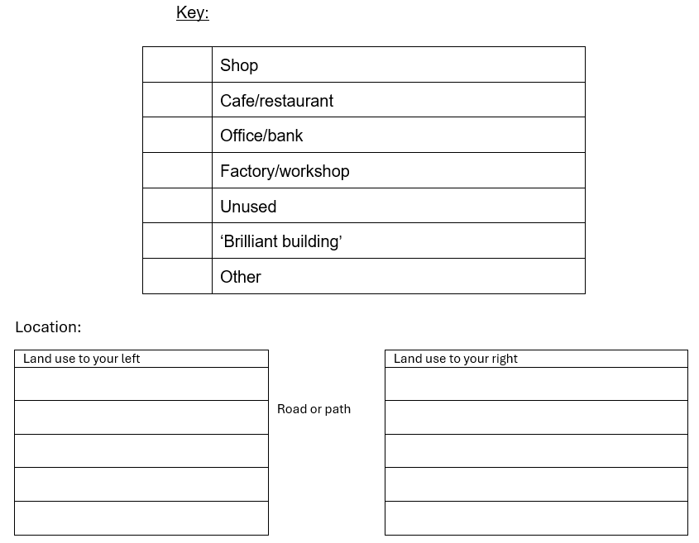
Data Presentation: Land use Transects
Your teacher will give you a sheet with a set of land use transects to complete to show your findings for each location.
They will model how to do this.
Answer the questions under the graphs on the sheet - you will need to know these answers for your Paper 3 exam.

Slide 8
Data Interpretation: Hypothesis 1
Hypothesis 1: Regenerated areas will be cleaner than areas which haven’t been regenerated
What does your cleanliness graph tell you? Did you find that Paintworks and Temple Quay are cleaner than the other two sites?
Decide if the hypothesis is true, false or needs amending. Give evidence to explain your choice. Quote figures from the graph.

Slide 9
Data Interpretation: Hypothesis 2
Hypothesis 2: Regenerated areas will be more accessible than areas which haven’t been regenerated.
What do your accessibility radar graphs tell you? Did you find that Paintworks and Temple Quay are more accessible than the other two sites?
What did the photos you took show? What about your secondary research into public transport?
Decide if the hypothesis is true, false or needs amending. Give evidence to explain your choice. Quote figures from the graphs & evidence from your photographs and research.

Slide 10
Data Interpretation: Hypothesis 3
Hypothesis 3: Regenerated areas will have fewer empty buildings, a wider range of land use and more ‘brilliant buildings’ than in areas that haven’t been regenerated.
What do your land use transects tell you? Did you find that Paintworks and Temple Quay had fewer empty buildings and a wider variety of land use than the other two sites? Which sites had more ‘brilliant buildings’?
Decide if the hypothesis is true, false or needs amending. Give evidence to explain your choice.

Slide 11
Conclusion: Is the regeneration of Temple Quarter achieving its vision?
Do your findings show that regenerated areas are clean and accessible? Do they seem to be thriving? Answer the question, using evidence to support your points.

Slide 12
Evaluation: What are the limitations of the data we collected?
Watch https://www.youtube.com/watch?v=64eSE7_-_p8 to find out about accuracy, reliability and validity.
How can we relate these concepts to our data collection?

Slide 13
Evaluation: How does this affect the reliability of our conclusions?
We can’t say that our conclusions are reliable as there are two many limitations in relation to our data collection - make sure you say why and give specific examples.

Slide 14
Evaluation: How could we improve this investigation?
How could we make our data collection more accurate, reliable and valid?
Are there other ways we could improve the investigation?

Slide 15
Reflection: Quick Quiz
What is the key question for our human geography investigation?
What are our three hypotheses? Remember CAR!
How did we collect primary data?
How did we collect secondary data?
Why did we use a bar graph to show our cleanliness data?
Why did we use radar graphs to show our accessibility data?
Did you decide that hypothesis 1 was true?
Give a limitation of one of our data collection methods
Are your conclusions reliable?

