Slide 1
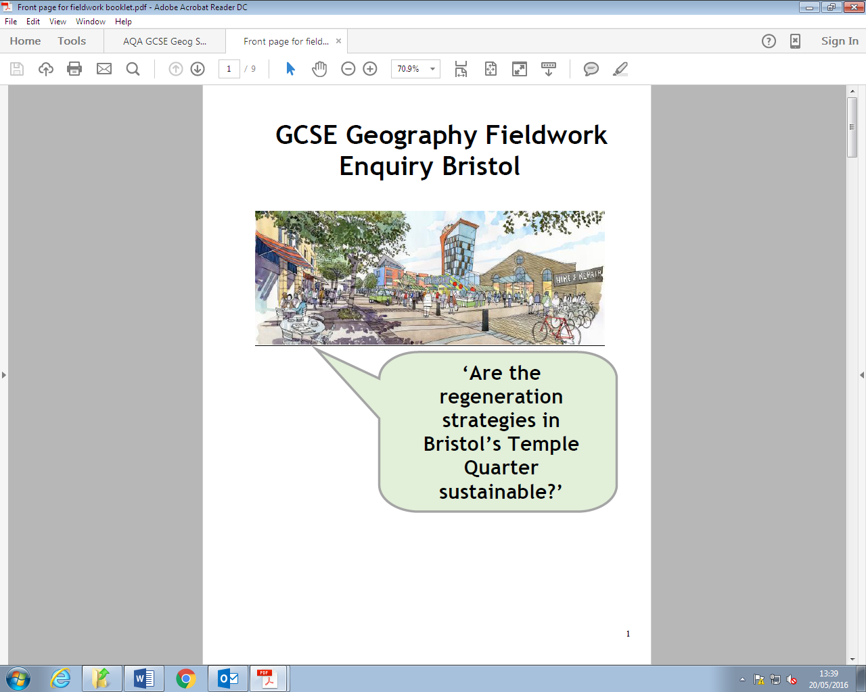

Human Geography Fieldwork
Do Now: What do you know about Bristol’s Temple Quarter?
What was it used for in the past?
Why did it fall into decline?
What is happening there now?
Is the regeneration of Temple Quarter achieving its vision?
Learning Objective: Prepare for our human geography fieldtrip

Slide 2

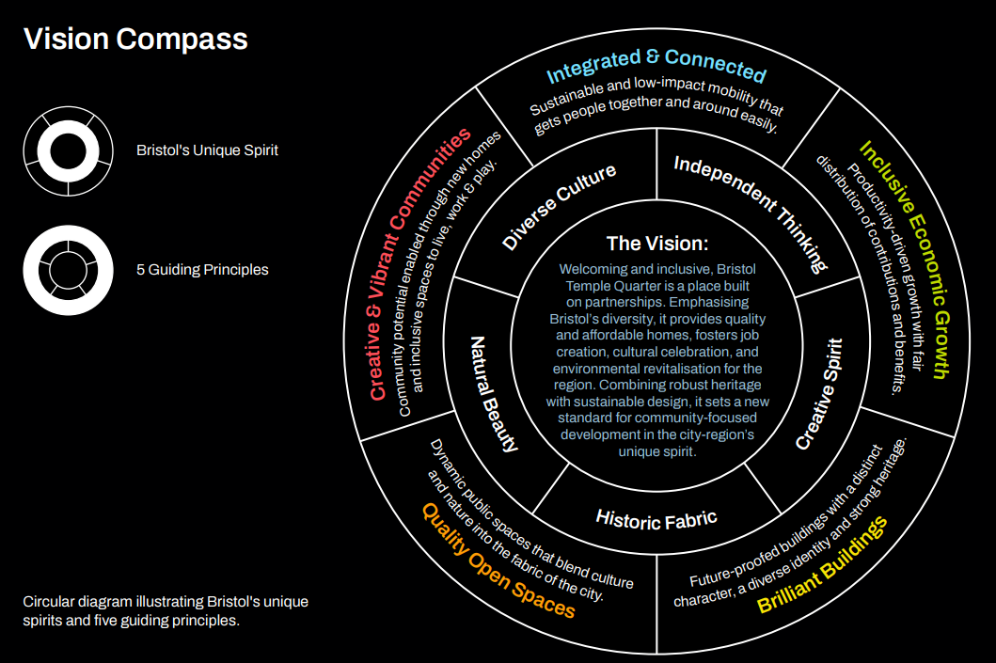
What is the vision for Temple Quarter?
‘Welcoming and inclusive, Bristol Temple Quarter is a place built on partnerships. Emphasising Bristol’s diversity, it provides quality and affordable homes, fosters job creation, cultural celebration, and environmental revitalisation for the region. Combining robust heritage with sustainable design, it sets a new standard for community-focused development in the city-region’s unique spirit.’

Slide 3
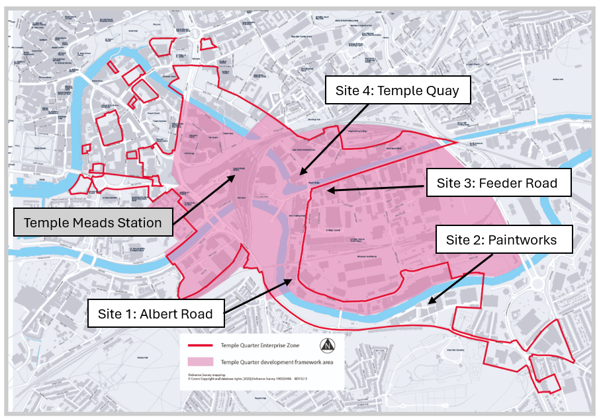
Why is this a good place to carry out our human geography fieldwork?
It is still being regenerated, so we can visit areas which have been regenerated (sites 2 and 4) and those that haven’t (sites 1 and 3)
We can travel there easily and sustainably by train or bus during the school day
The site is small enough that we can visit quite a lot of it in a few hours

Slide 4

Recall: Why is this a good place to carry out our human geography fieldwork?

Slide 5
How will we collect data?
We will visit four sites within Temple Quarter Enterprise Zone
You will work in groups to collect the same data at each site, recording your findings carefully on your sheets
You will be able to use mobile phones to help you locate your study points and to take photographs

Slide 6

What hypotheses will we test?
We will find out if Temple Quarter’s regeneration is achieving its vision by testing three hypotheses:
Hypothesis 1: Regenerated areas will be cleaner than areas which haven’t been regenerated. Clean areas are a sign that an area is thriving socially.
Hypothesis 2: Regenerated areas will be more accessible than areas which haven’t been regenerated. Accessibility is an important aspect of a being inclusive and connected.
Hypothesis 3: Regenerated areas will have fewer empty buildings, a wider range of land use and more ‘brilliant buildings’ than in areas that haven’t been regenerated. Buildings in use in a range of ways indicate an area is mixed use and is thriving economically.
How will these hypotheses help us to answer our main question?

Slide 7
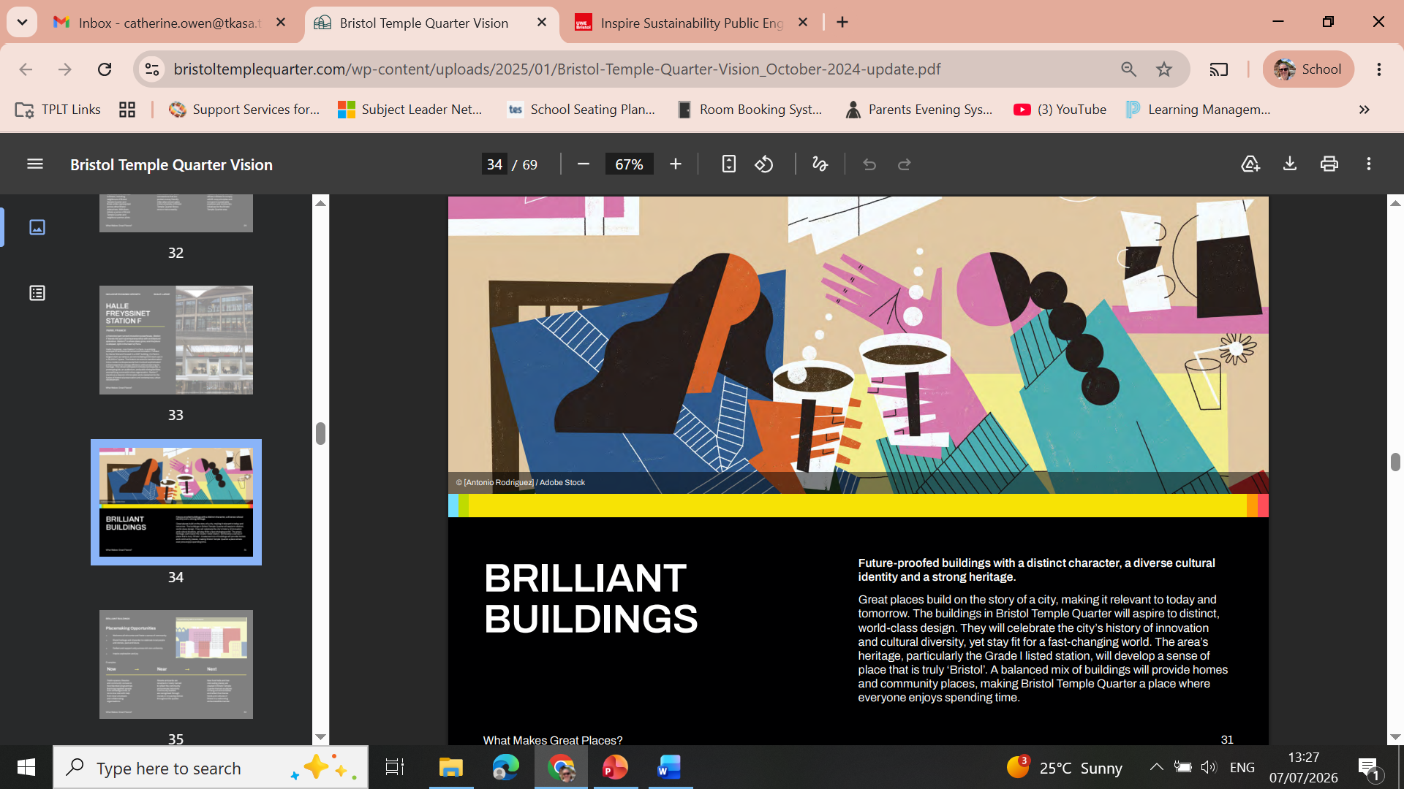
What are ‘brilliant buildings’?
From: p.31 https://www.bristoltemplequarter.com/wp-content/uploads/2025/01/Bristol-Temple-Quarter-Vision_October-2024-update.pdf

Slide 8
What hypotheses will we test?
Think of these key terms from our hypotheses:
Cleanliness
Accessibility
Range of Land Use
How will you remember these? Would the acronym CAR help? Can you think of other strategies?

Slide 9
Recall: What hypotheses will we test?

Slide 10
We will collect primary data so that we can test these hypotheses:
Cleanliness Survey – We will give each area a score from 0 to -5 to show how clean it is. We will also note any useful information which could explain the cleanliness.
Accessibility Index
  We will complete a bi-polar survey to see how accessible each area is.
  We will also take photographs showing positive and negative features in relation to accessibility, using what3words to geolocate each photograph.
Land use Transect -We will complete a land use transect for 100 paces in each area, recording the land use on each side every 20 paces. We will take photographs of any ‘brilliant buildings’ we come across.
We will also collect secondary data by looking online to see how well each area is connected by public transport, helping us to test hypothesis 2.

Slide 11
What is ‘What Three Words’? https://www.youtube.com/watch?v=DLG6WFx3XHQ

Slide 12
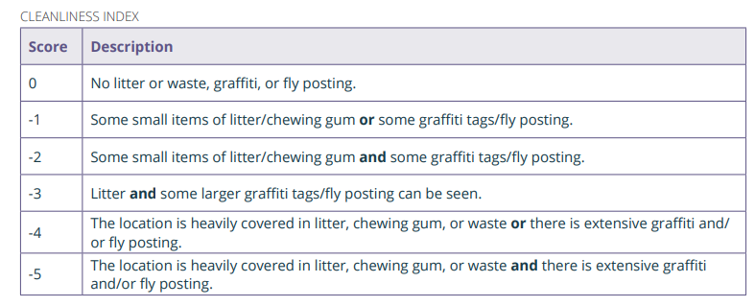
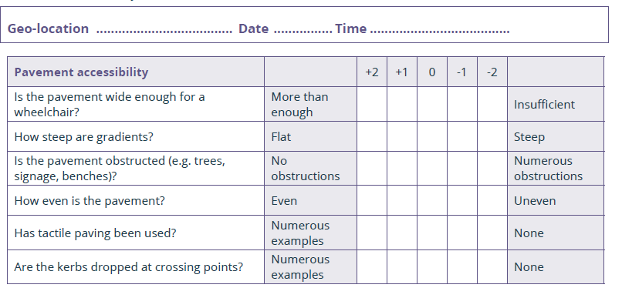
Recording data
Accessibility Survey
How does this data link to our hypotheses?

Slide 13
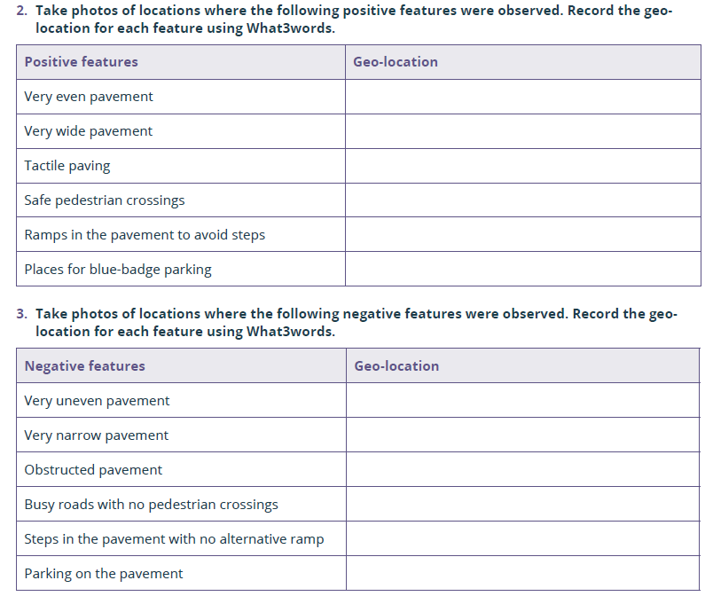
Recording data
Photographs related to accessibility
How does this data link to our hypotheses?

Slide 14
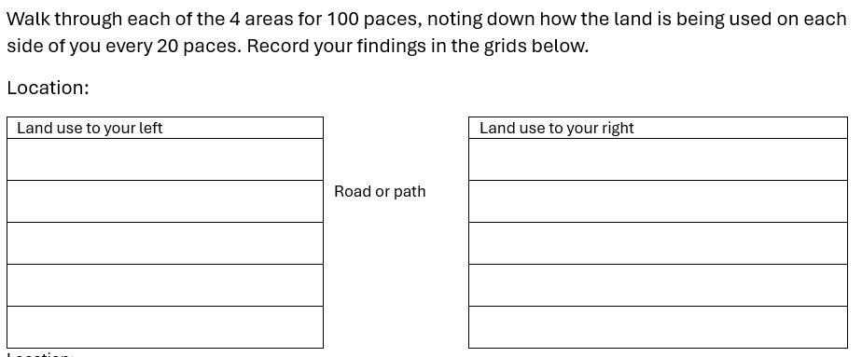
Recording data
Land use transect
How does this data link to our hypotheses?

Slide 15
Recall: What hypotheses will we test?
What are the three key terms you are remembering?
How will our data collection help us to test these hypotheses?
How will the data help us to answer our key question?

Slide 16

Risk Assessment
Risk | What could happen? | How can we prevent this?
Missing a train
Being injured by a car
Getting lost
How could we complete the first row?

Slide 17

Risk Assessment
Risk | What could happen? | How can we prevent this?
Missing a train
Being injured by a car
Getting lost
Complete the grid on your sheet

Slide 18
Secondary research
We will find out more about the accessibility of each area by finding out how well connected it is by public transport.
We will find out how far each location is from Temple Meads and use the internet to find out about bus routes in each location.
How does this data link to our hypotheses?
What is the difference between primary and secondary data collection?
https://www.youtube.com/watch?v=zSdnd9MznPk

Slide 19
Recall: Can you remember one risk and how it will be prevented?

Slide 20
Visit information
You must wear ___________for this visit – it may be cold or rain, so bring a coat
Whilst in Bristol you must stay with your group.
You must follow any instructions given to you by staff immediately.
You will need to bring something to write with and something to eat and drink (or money to buy this).
You can bring your phone but will be responsible for looking after it.
You will have two breaks during the field visit – one at Paintworks and one at Temple Quay
Any questions?

Slide 21
Recall: Can you remember our key question?
What are the hypotheses we will test to answer this question?

Slide 22

Reflection…
What do you need to do to ensure that you will be ready to go on your field visit and collect the data you need on _______________?

